Slide 1
Command Line Trics
Albina Sidikova
03/16/2021
Metis Bootcamp

Slide 2

The command line is a text interface for your computer
Notes:
The command line is a text interface for your computer. It's a program that takes in commands, which it passes on to the computer's operating system to run. From the command line, you can navigate through files and folders on your computer

Slide 3
TAB
01
Default
Create Aliases
05
02
KILLALL
Pimp your prompt
Plan of investigation
06
03
Change flags
History
07
04
Bonus
08
Keyboard shortcut

Slide 4
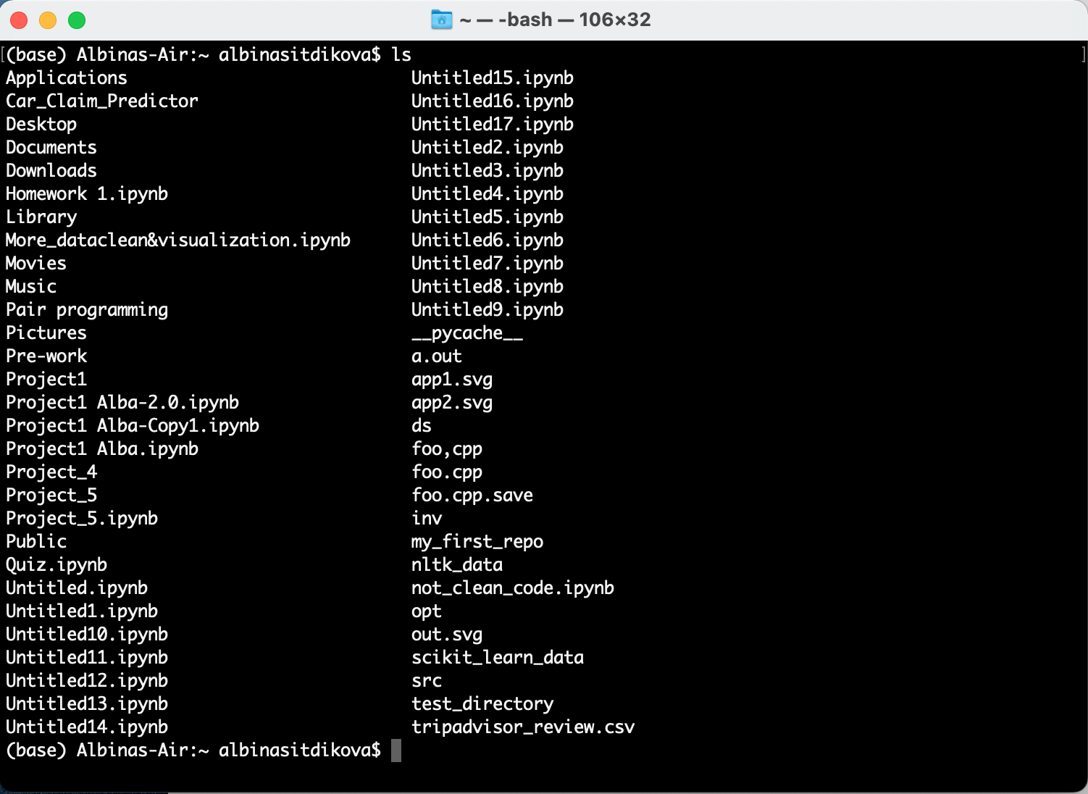
TAB - tab completion for file/directory names

Slide 5
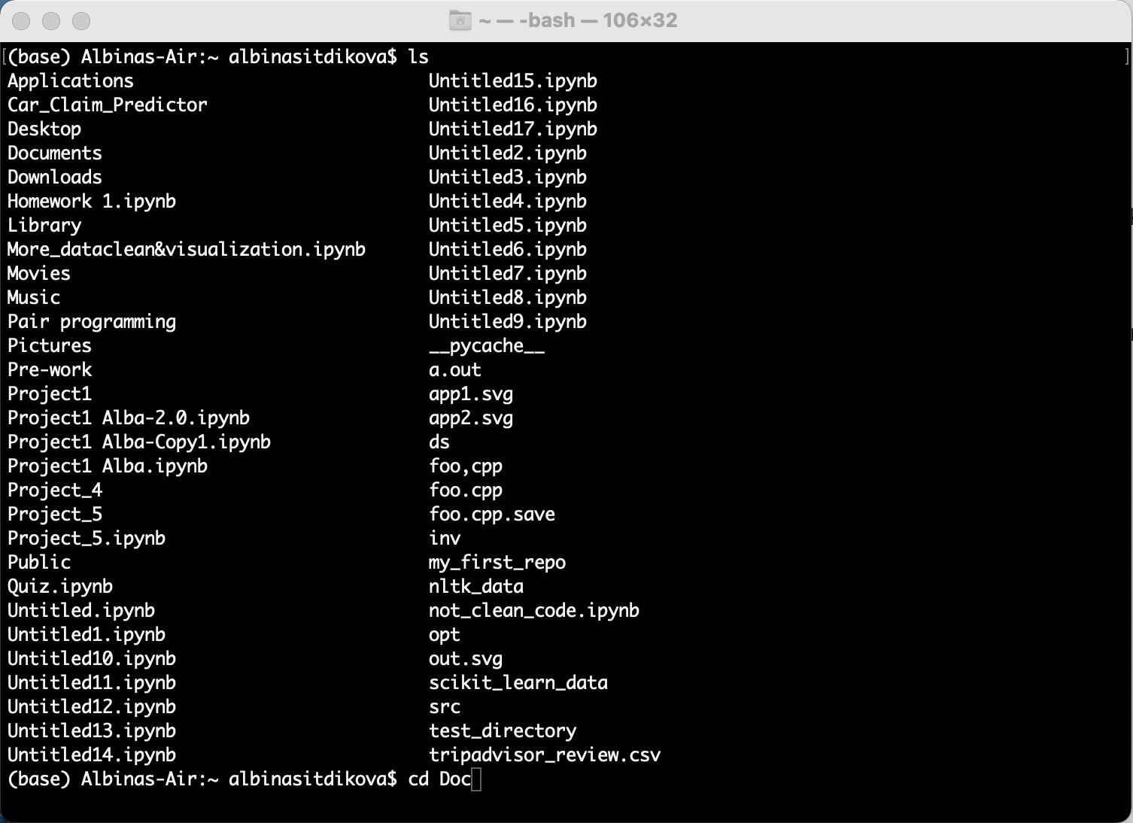
TAB
TAB

Slide 6
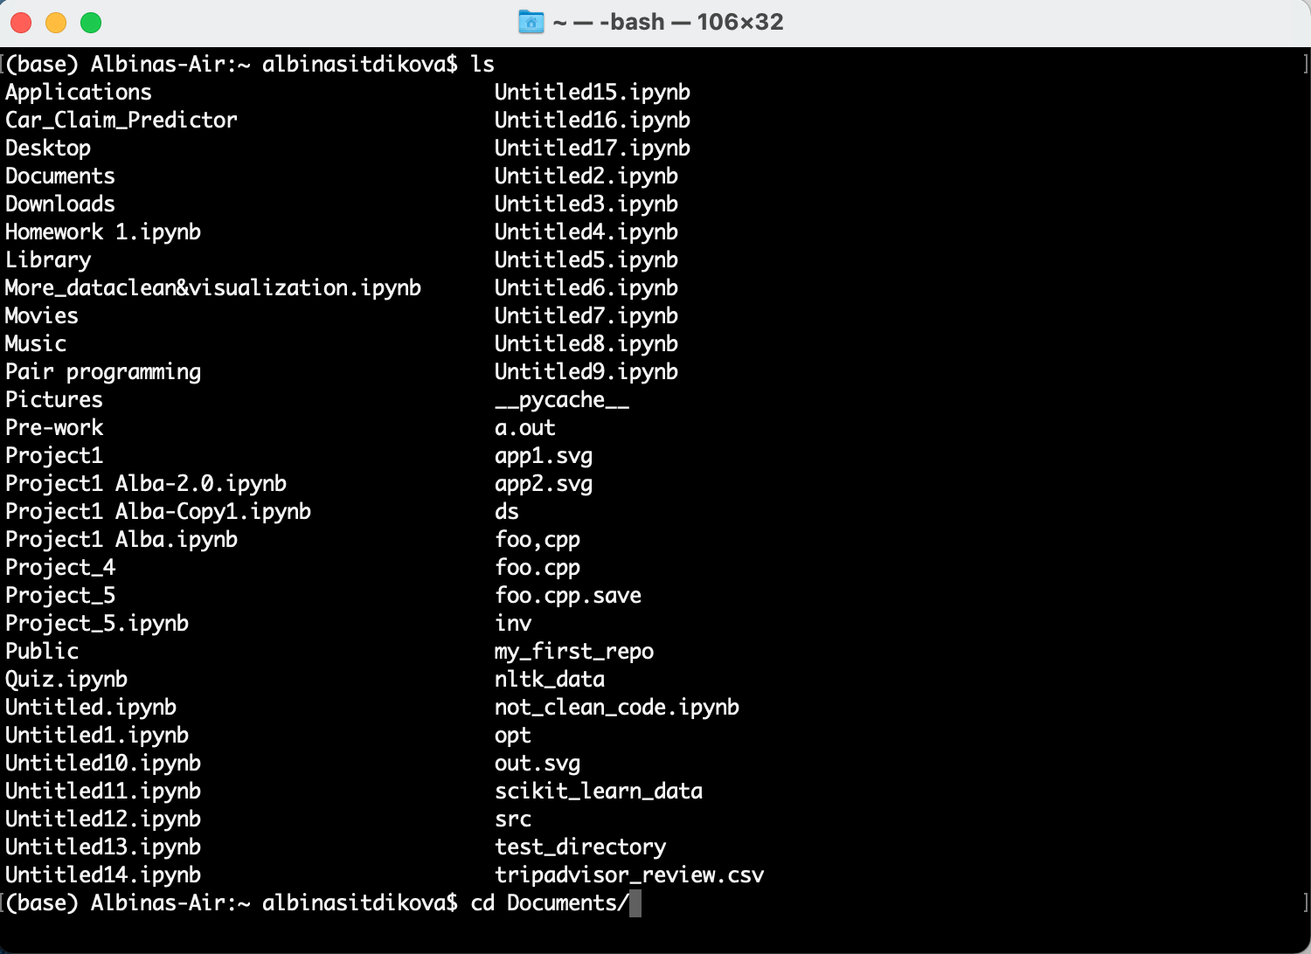
TAB
TAB

Slide 7

TAB
TAB TAB

Slide 8
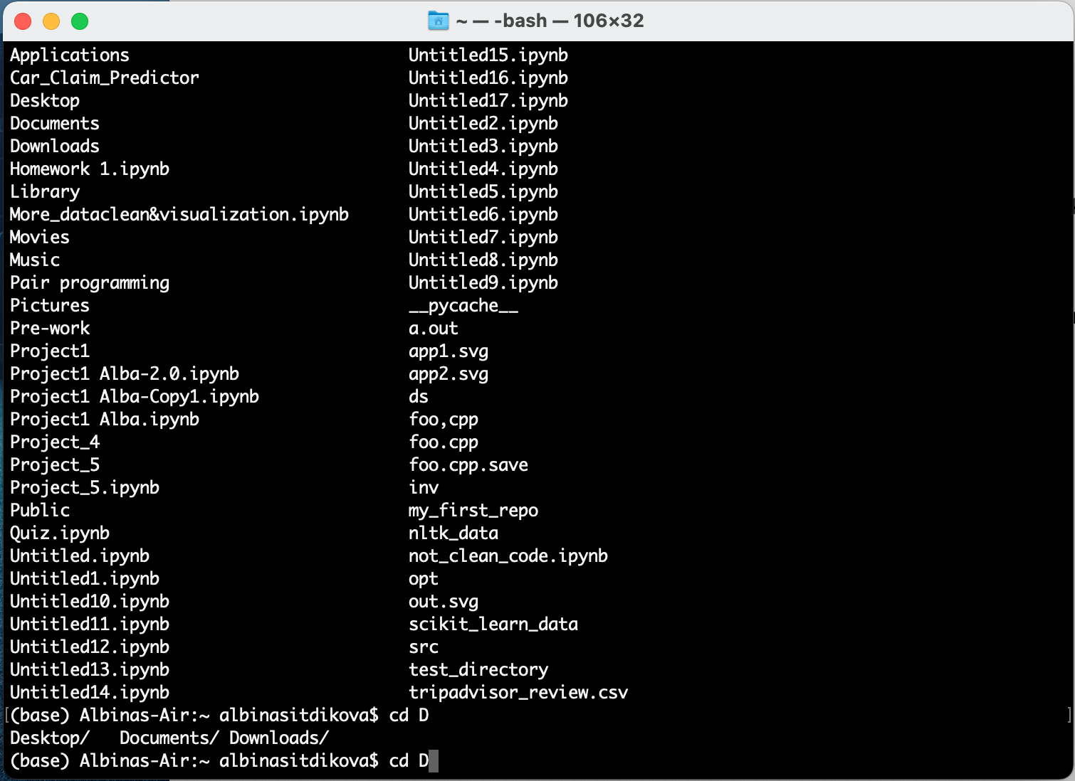
TAB
TAB TAB

Slide 9
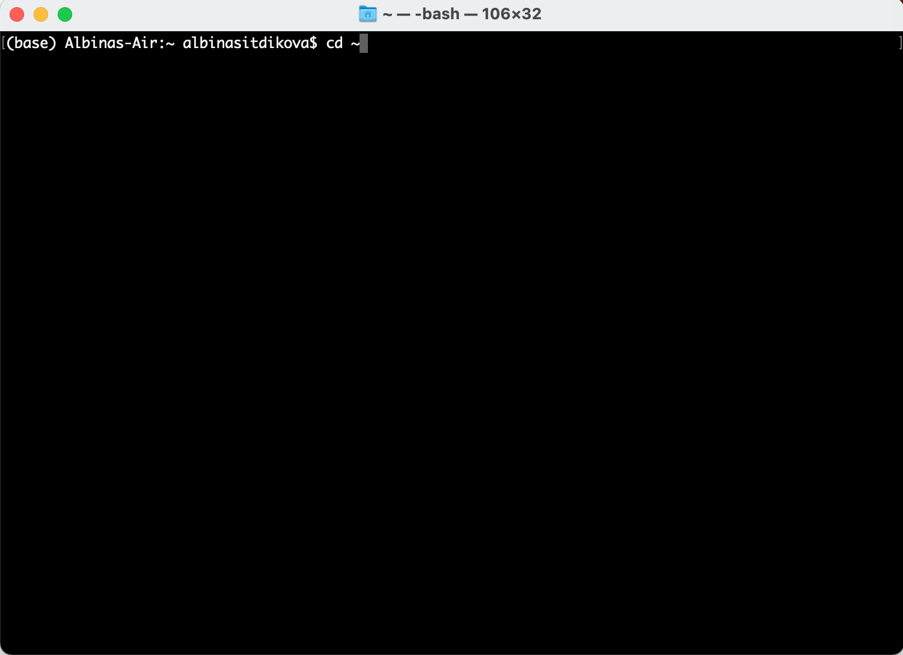
2. Create aliases
Navigate to your home directory:
cd ~
Open up .bash_profile using vi:
vi .bash_profile
Add an alias (press i):
alias $preferredAlias=“$commandToAlias”
Save the file(press Escape, type :wq, and hit Enter)
Restart Terminal

Slide 10
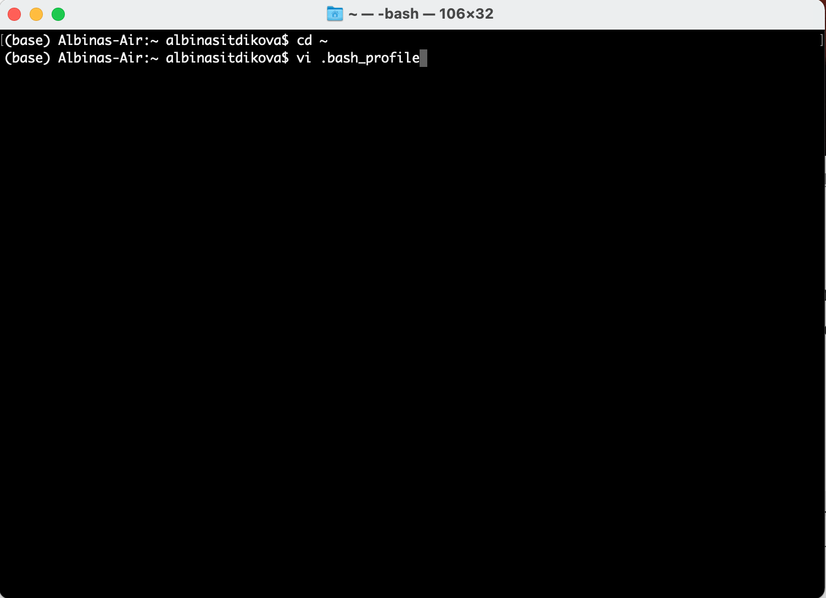
Create aliases
Navigate to your home directory:
cd ~
Open up .bash_profile using vi:
vi .bash_profile
Add an alias (press i):
alias $preferredAlias=“$commandToAlias”
Save the file(press Escape, type :wq, and hit Enter)
Restart Terminal

Slide 11
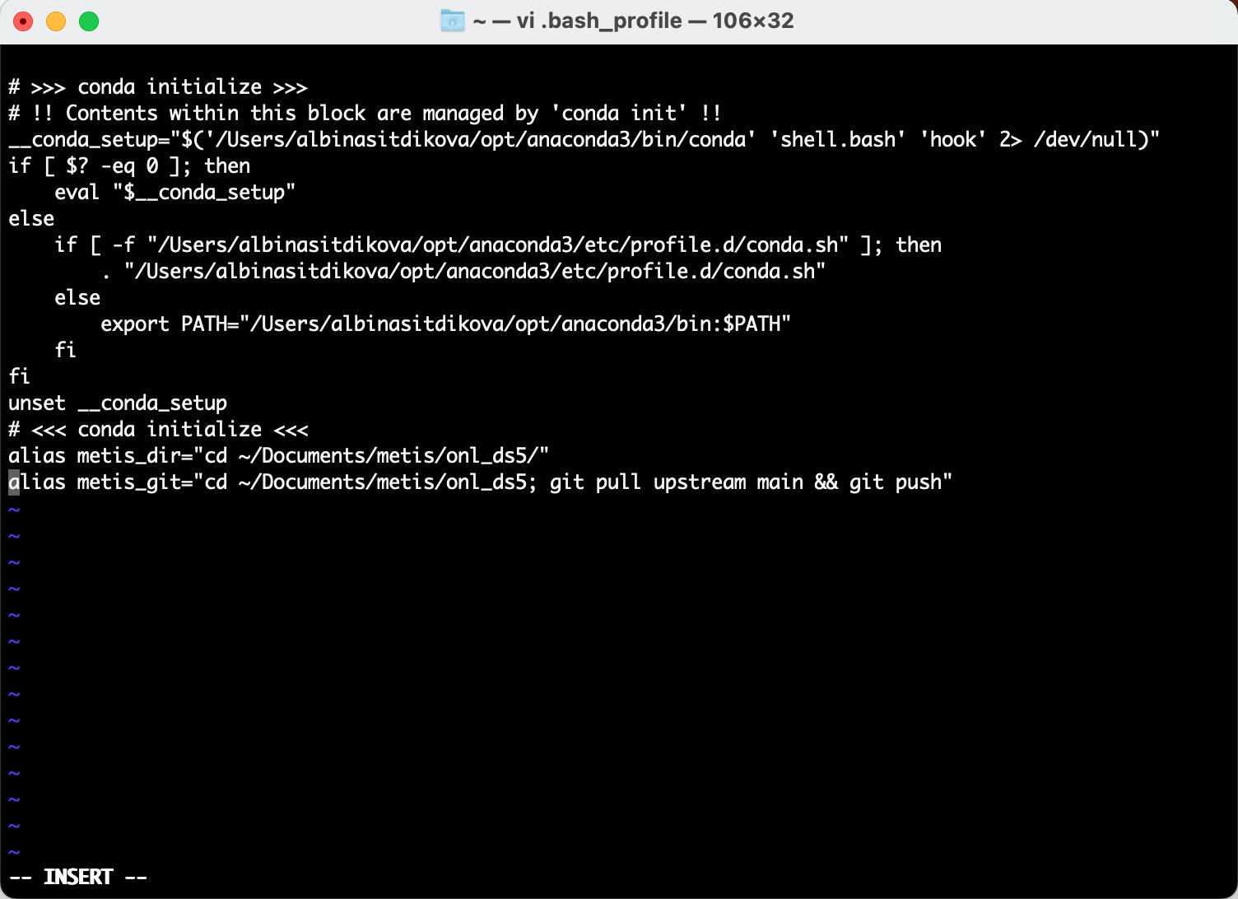
Create aliases
Navigate to your home directory:
cd ~
Open up .bash_profile using vi:
vi .bash_profile
Add an alias (press i):
alias $preferredAlias=“$commandToAlias”
Save the file(press Escape, type :wq, and hit Enter)
Restart Terminal
Preferred alias
Command To Alias

Slide 12
Create aliases
Navigate to your home directory:
cd ~
Open up .bash_profile using vi:
vi .bash_profile
Add an alias (press i):
alias $preferredAlias=“$commandToAlias”
Save the file(press Escape, type :wq, and hit Enter)
Restart Terminal

Slide 13

Create aliases
Navigate to your home directory:
cd ~
Open up .bash_profile using vi:
vi .bash_profile
Add an alias (press i):
alias $preferredAlias=“$commandToAlias”
Save the file(press Escape, type :wq, and hit Enter)
Restart Terminal

Slide 14
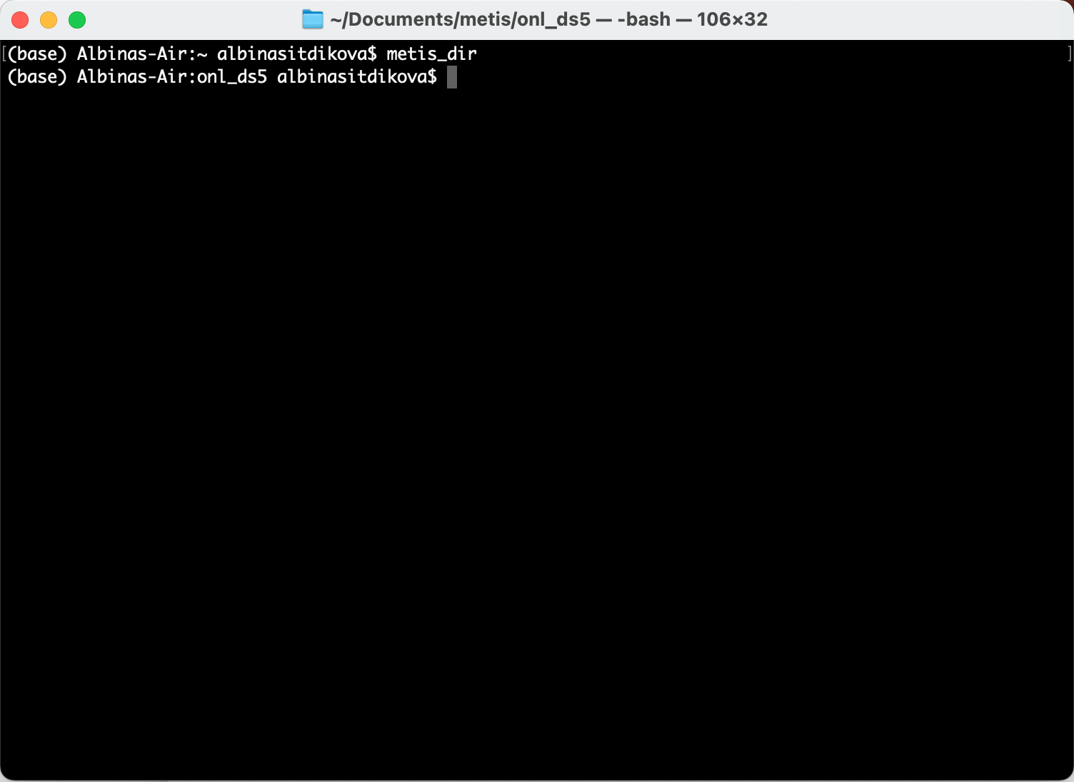
Create aliases
Navigate to your home directory:
cd ~
Open up .bash_profile using vi:
vi .bash_profile
Add an alias (press i):
alias $preferredAlias=“$commandToAlias”
Save the file(press Escape, type :wq, and hit Enter)
Restart Terminal
alias metis_dir="cd ~/Documents/metis/onl_ds5/"

Slide 15
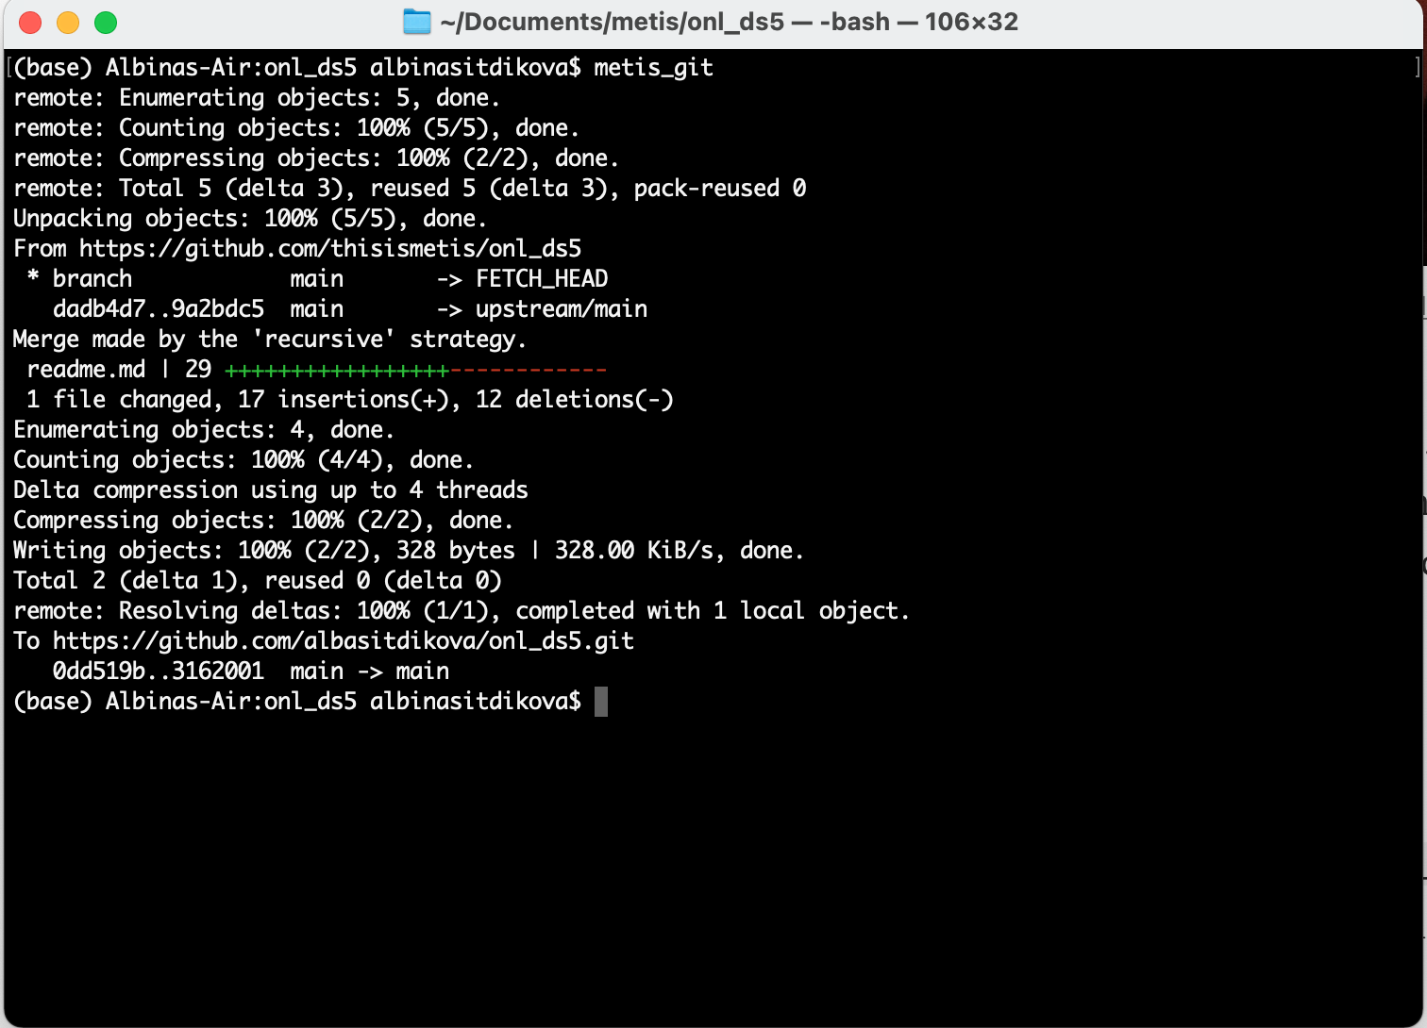
Create aliases
Navigate to your home directory:
cd ~
Open up .bash_profile using vi:
vi .bash_profile
Add an alias (press i):
alias $preferredAlias=“$commandToAlias”
Save the file(press Escape, type :wq, and hit Enter)
Restart Terminal
alias metis_git="cd ~/Documents/metis/onl_ds5; git pull upstream main && git push"

Slide 16
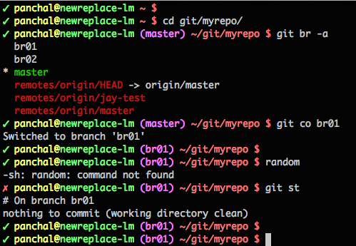
3. Pimp your prompt

Slide 17
Pimp your prompt
Navigate to your home directory:
cd ~
Open up .bash_profile using vi:
vi .bash_profile
Add the following line (press i):
export PS1=”$ ”
Save the file(press Escape, type :wq, and hit Enter)
Restart Terminal

Slide 18
Pimp your prompt
Navigate to your home directory:
cd ~
Open up .bash_profile using vi:
vi .bash_profile
Add the following line (press i):
export PS1=”$ ”
Save the file(press Escape, type :wq, and hit Enter)
Restart Terminal

Slide 19
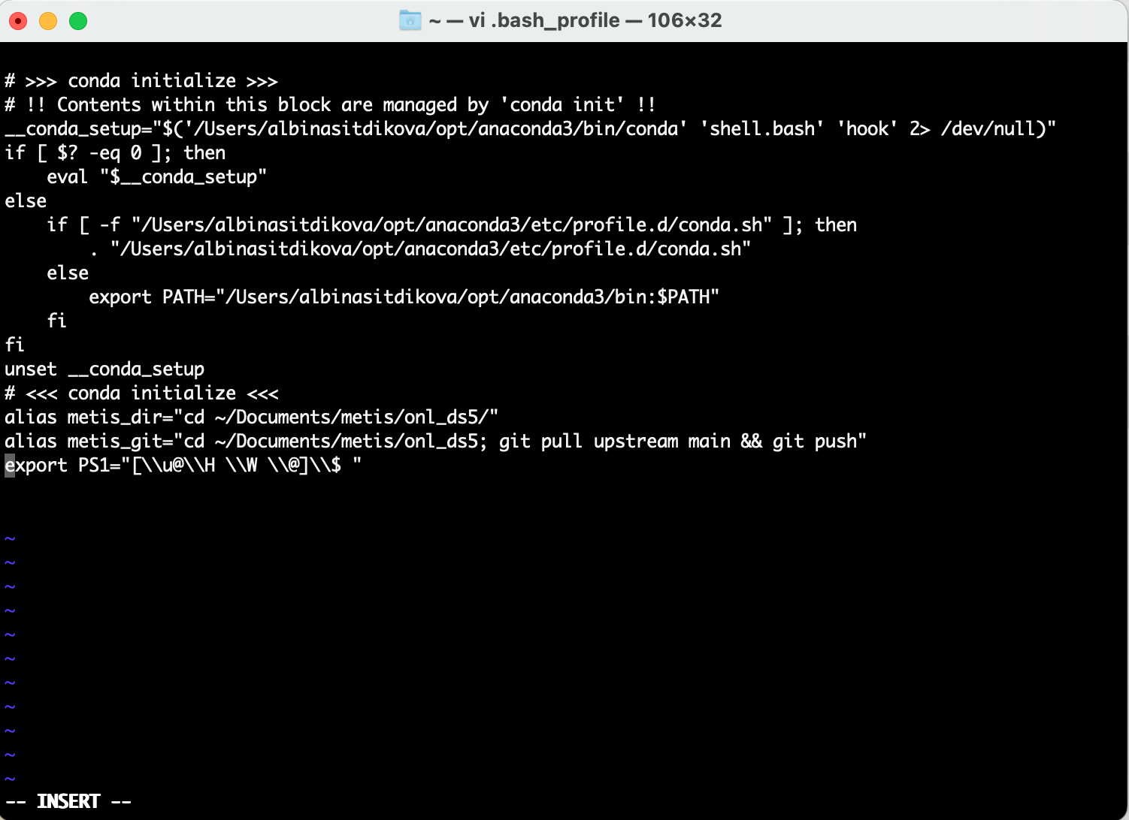
Pimp your prompt
Navigate to your home directory:
cd ~
Open up .bash_profile using vi:
vi .bash_profile
Add the following line (press i):
export PS1=”$ ”
Save the file(press Escape, type :wq, and hit Enter)
Restart Terminal

Slide 20
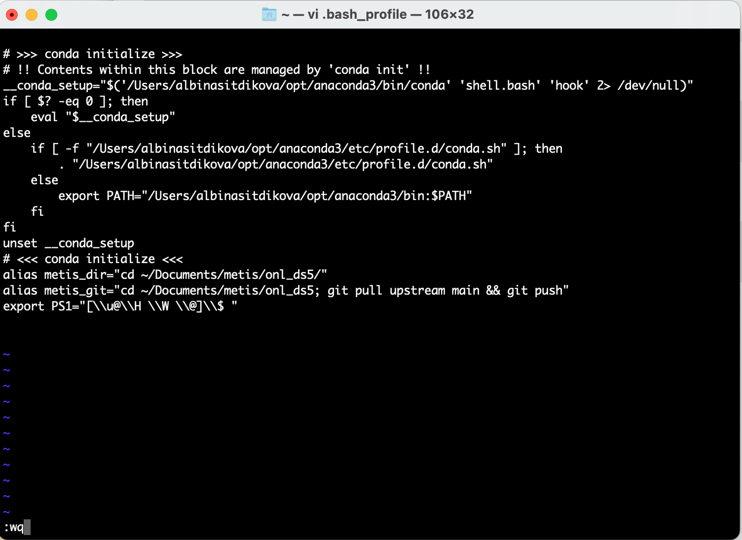
Pimp your prompt
Navigate to your home directory:
cd ~
Open up .bash_profile using vi:
vi .bash_profile
Add the following line (press i):
export PS1=”$ ”
Save the file(press Escape, type :wq, and hit Enter)
Restart Terminal

Slide 21
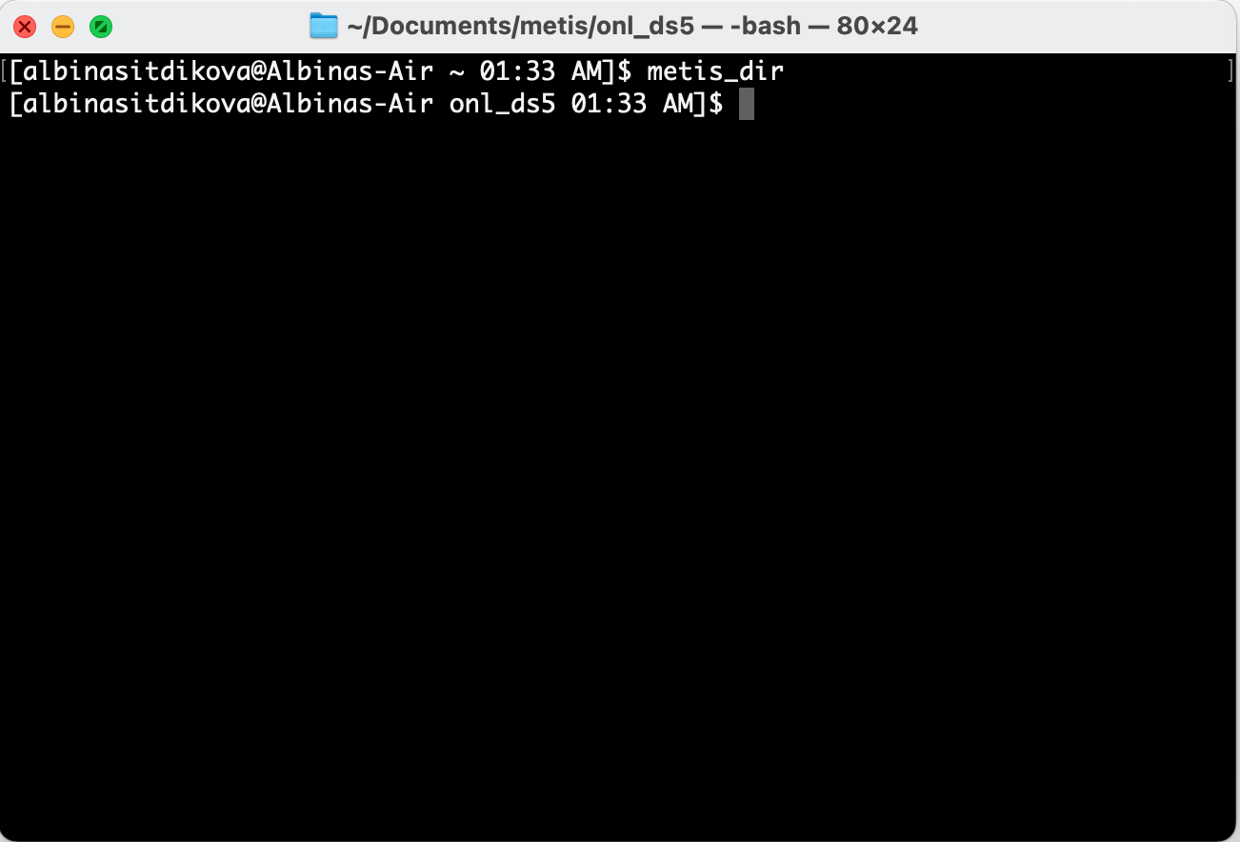
Pimp your prompt
Navigate to your home directory:
cd ~
Open up .bash_profile using vi:
vi .bash_profile
Add the following line (press i):
export PS1=”$ ”
Save the file(press Escape, type :wq, and hit Enter)
Restart Terminal

Slide 22
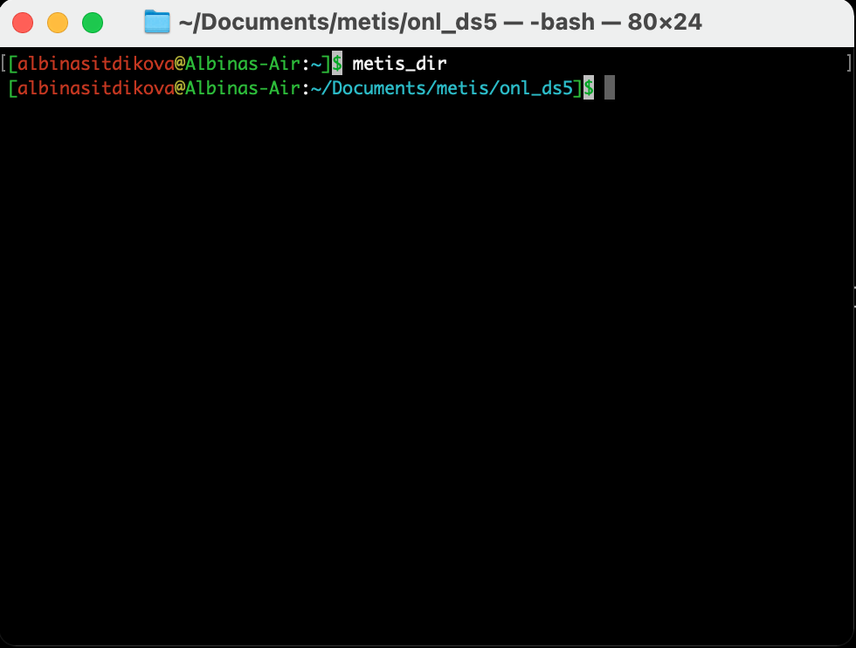
Pimp your prompt

Slide 23
Pimp your prompt
\u: Display the current username
\h: Display the hostname
\W: Print the base of current working directory.
\H: Display FQDN (fully qualified domain name) hostname
\@: Display current time in 12-hour am/pm format
$: usually marks the end of the prompt

Slide 24
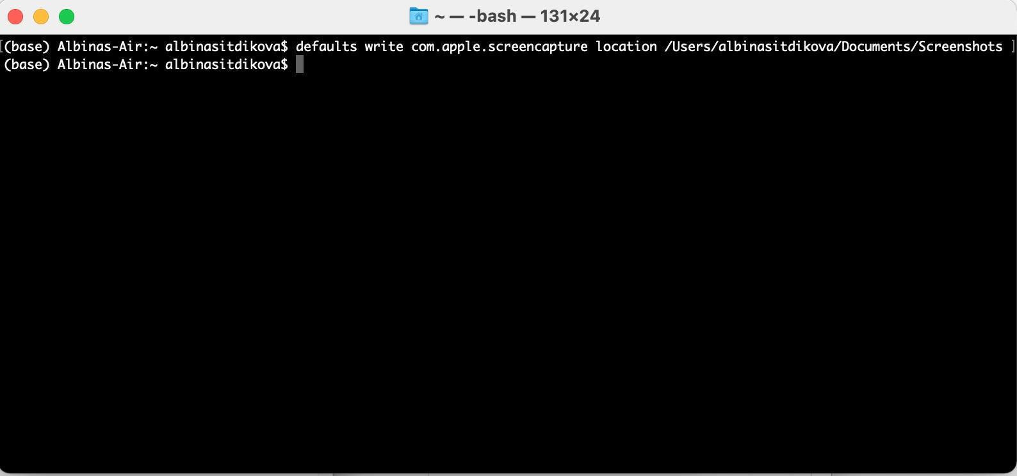
4. Defaults
Change screenshot default location
Notes:
This command is often used in Terminal tips and tricks to tweak applications and system settings via their preference files

Slide 25
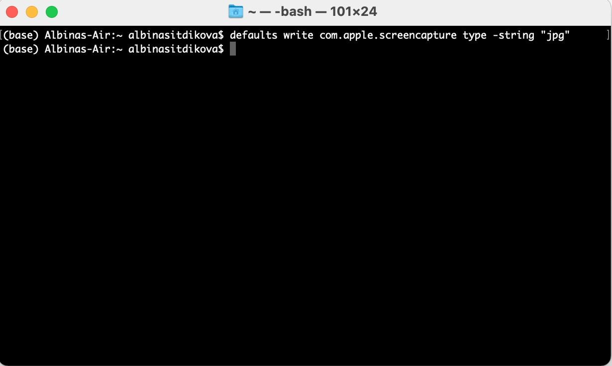
Defaults
Change screenshot default type
Notes:
This command is often used in Terminal tips and tricks to tweak applications and system settings via their preference files

Slide 26
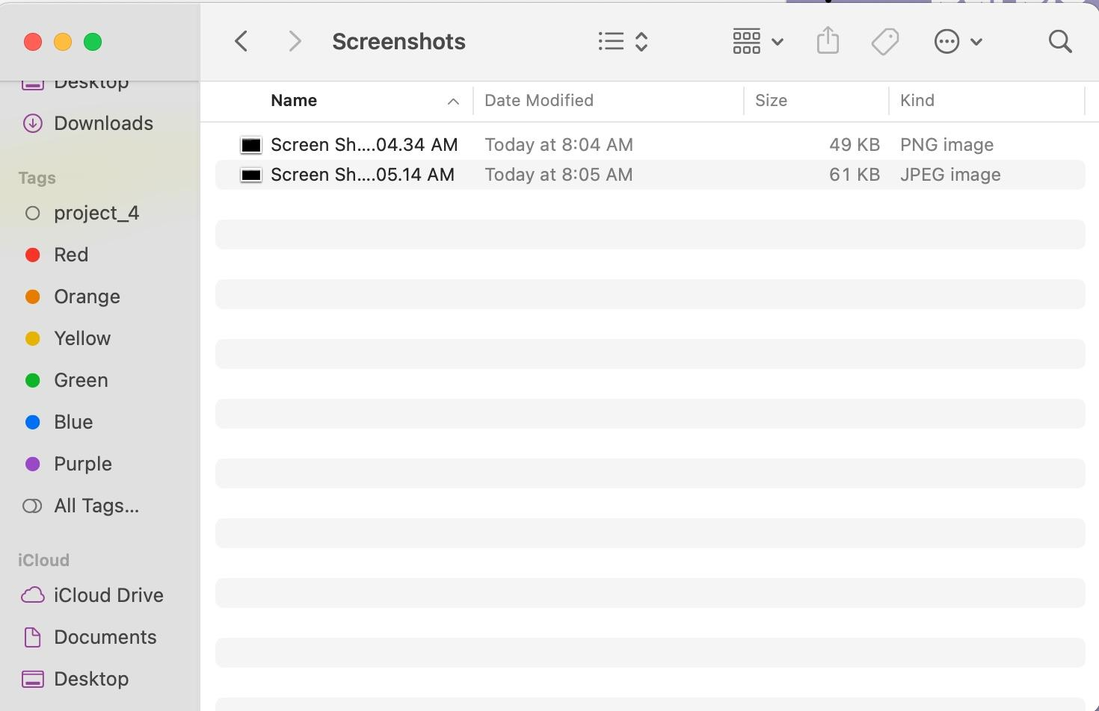
Defaults
Location changed
Type changed
Notes:
This command is often used in Terminal tips and tricks to tweak applications and system settings via their preference files

Slide 27
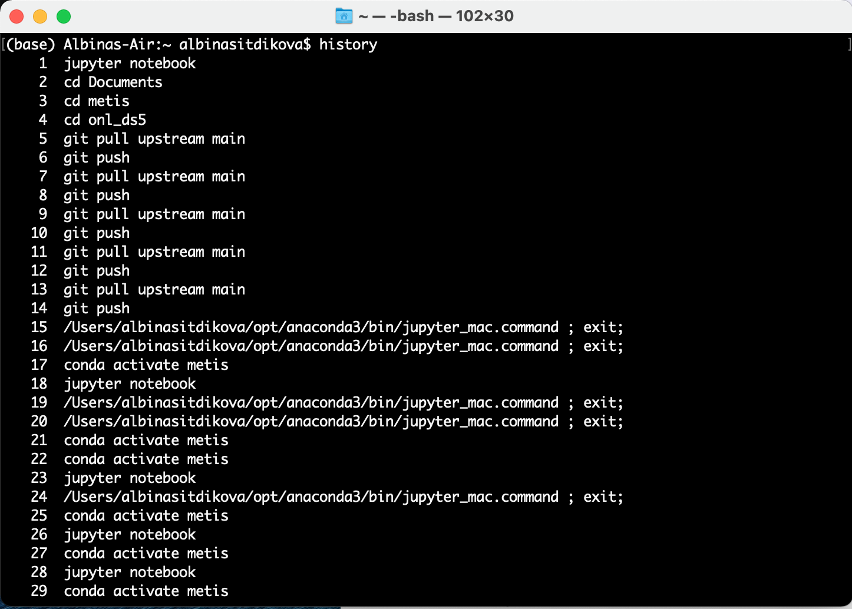
5. History

Slide 28
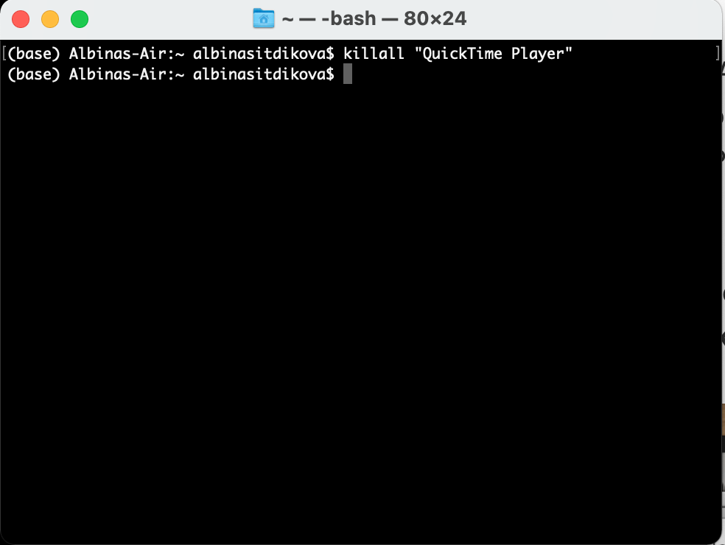
6. KillAll

Slide 29
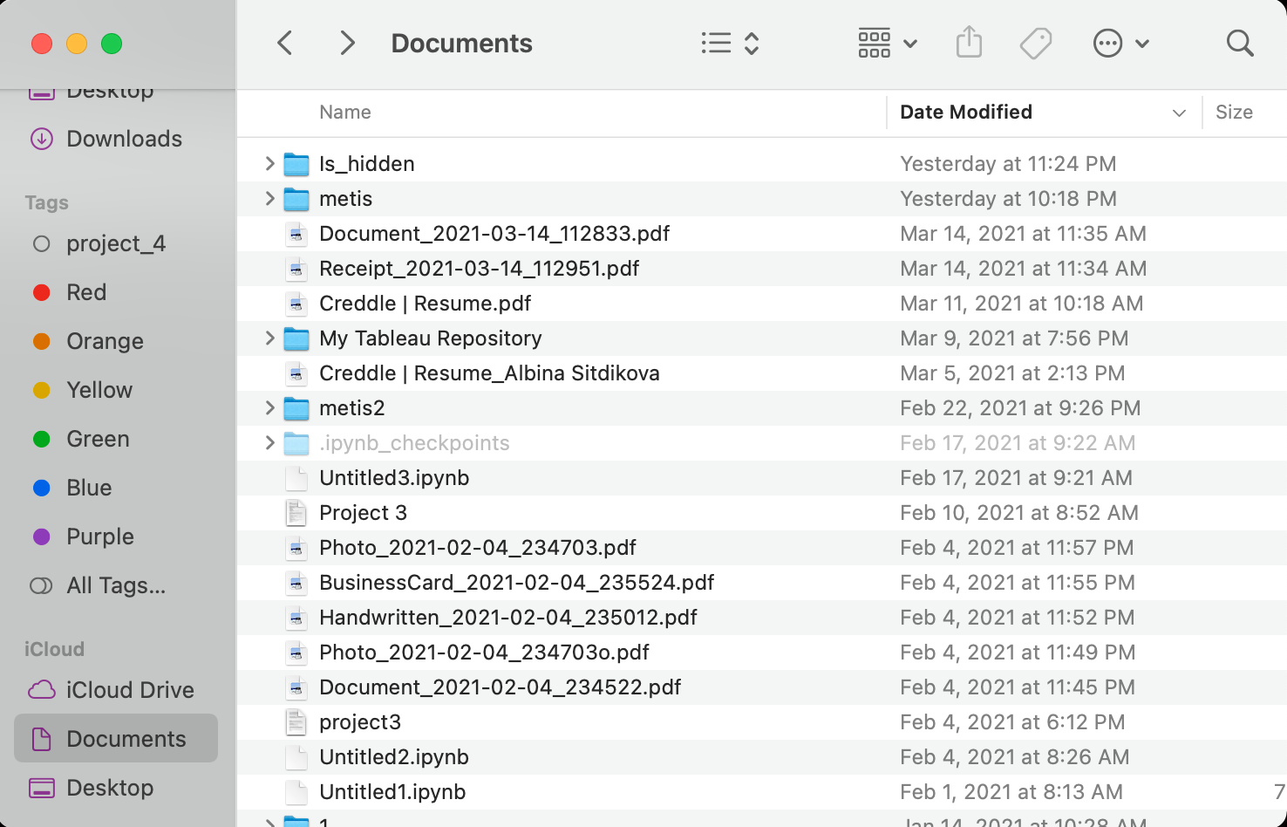
7. Change flags
(“hidden” and “nohidden”)
Notes:
Change flags: hidden and unhidden

Slide 30
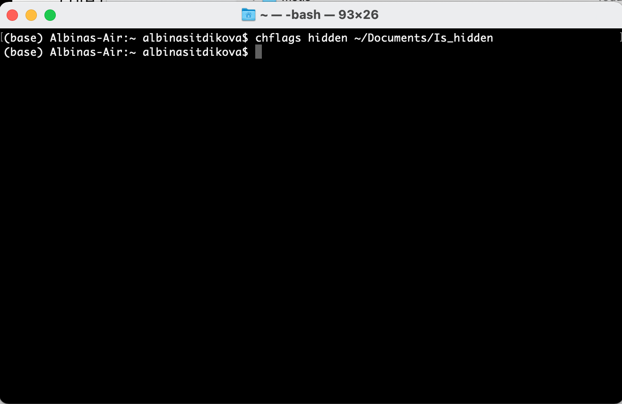
Change flags
(“hidden” and “nohidden”)
Notes:
Change flags: hidden and unhidden

Slide 31
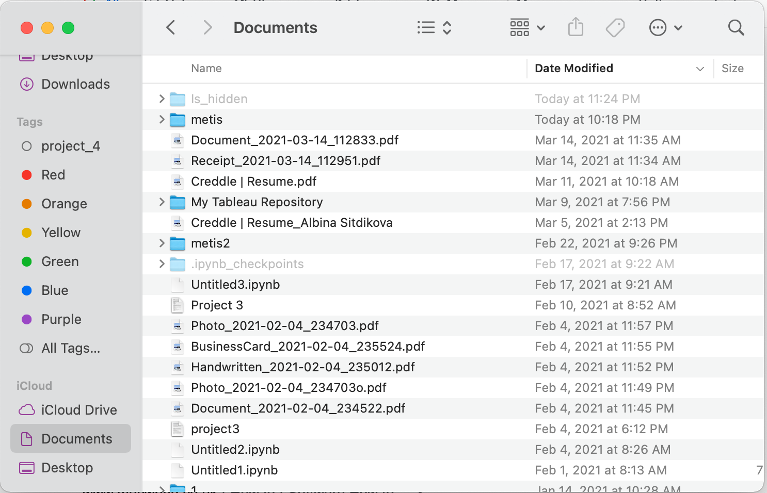
Change flags
(“hidden” and “nohidden”)
Notes:
Change flags: hidden and unhidden

Slide 32
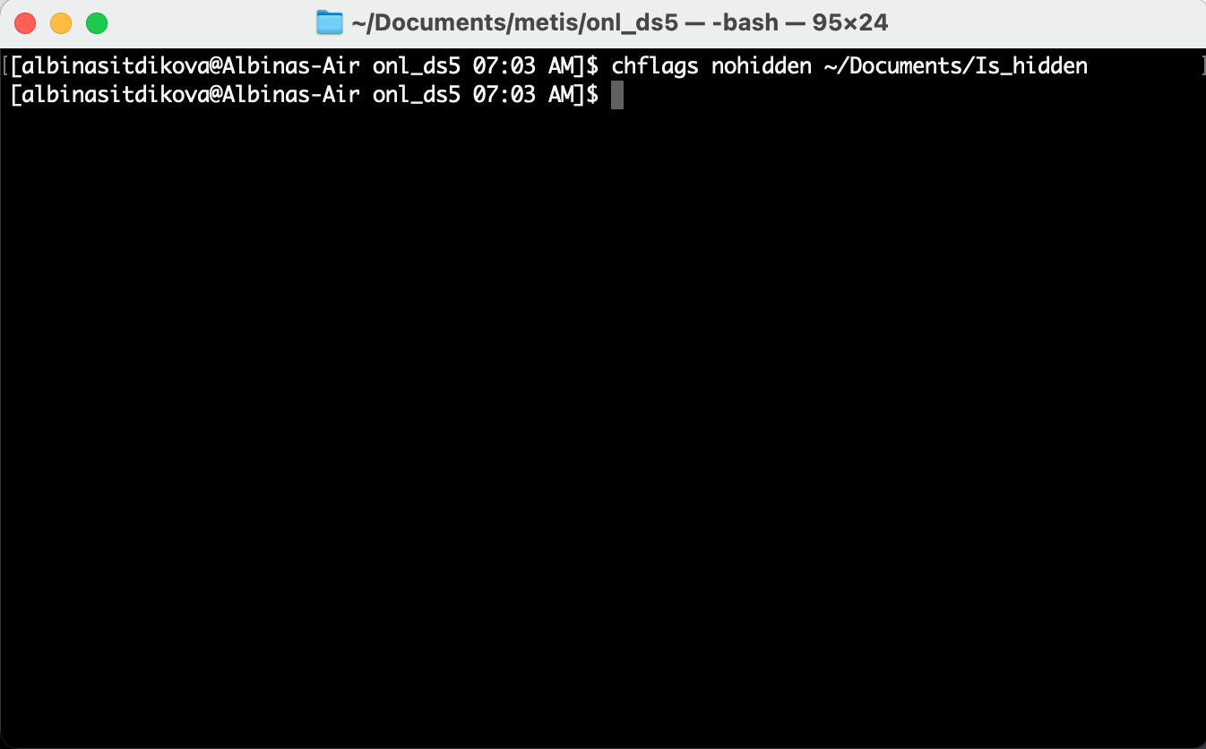
Change flags
(“hidden” and “nohidden”)
Notes:
Change flags: hidden and unhidden

Slide 33
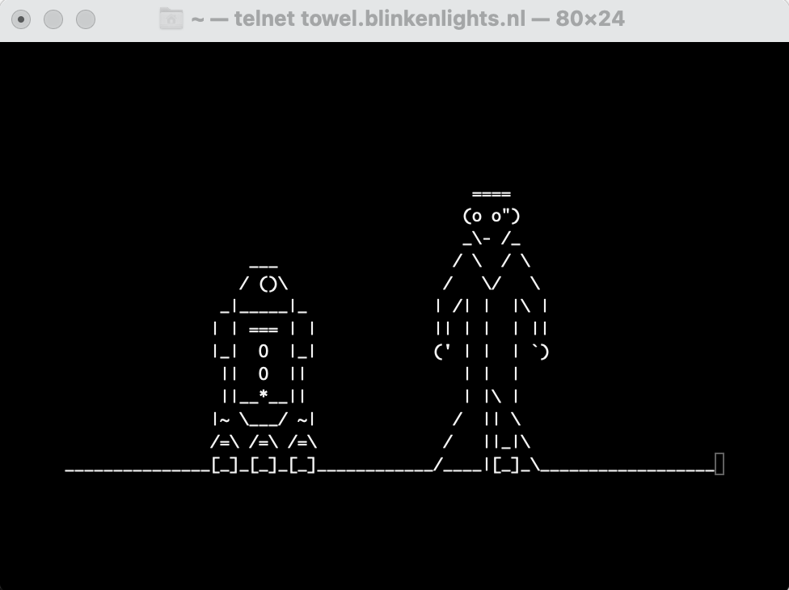
8. STAR WARS
Install Homebrew on Mac OS
Open up .bash_profile using vi:
brew install telnet
Hit Return and let Homebrew download and install Telnet to the Mac
To see Star Wars IV you can run:
telnet towel.blinkenlights.nl

Slide 34
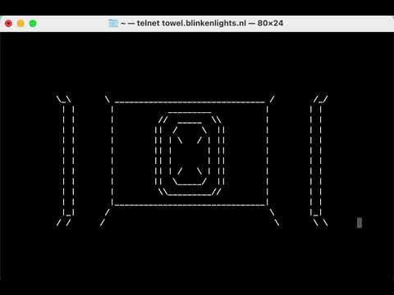
STAR WARS

Slide 35
THANKS
Does anyone have any questions?

